Slide 1
Introduction to Classical Control & Systems Modeling
Chris Palie E.I.T.
ATIRCM MBL System Engineer and Requirements Manager
Phone: 5-1202
Location: MER15, Floor Near 2nd, North Side near the 4J Pole

Slide 2
Agenda Topics
Quick Background
  Ice Breaker
Systems with Controls
Review of Laplace Transforms
Systems Modeling
Solutions of Differential Equations
  Laplace Methods
  State Space Methods
    Break
2nd Order Linear Systems
  Control Systems Behavior (Step)
    Resonances
    Damping
    Overshoot
    Settling Time
    Break
ROOT Locus for Stability
PID Controller

Slide 3
Quick Background
Graduate of Wentworth Institute of Technology with Bachelors in ELME, FE Certified (E.I.T.)
Graduate of University of Massachusetts Lowell with Masters in EE with a Concentration in Controls
1st Rotation was at NCA on ATIRCM/CMWS, Reliability
  Highly Accelerated Life Testing (HALT)
  Failure Review Analysis
2nd Rotation was at AS&T on ODAM & Advanced Beacon, Mechanical Design
  ODAM – Mechanical Design of Wing Deployment for the Mortar
  Advanced Beacon – Mechanical Design of Beacon Charger and Cradle
3rd Rotation was at NCA on STARBUCK, Systems Engineering
  EMI Testing ALQ-144, Passed DO-160 for the 1st time in over 30 yrs of existence
  Worked on system integration for the Kona System on STARBUCK Platforms
  Data Reduction Lead for Kona Live Fire to prove to the company and the customer that the Kona System (Similar to ATIRCM) works
4th Rotation was at NCA on FIRST, Coordinator
  Coordinator for all FIRST contact information through BAE Systems OG1
  PM for MHS FIRST Team
5th Rotation was/is at MER on ATIRCM MBL
  Requirements Manager for MBL
  Integration and Test SE for MBL
  SE Test Lead for Qual Testing
FIRST Volunteer Work
  FLL NH Deputy Partner in 2007
  FLL NH Co-Operational Partner 2008-Present
  FRC Co-Lead Mentor MHS Team 166 2006-Present
  FIRST Intern Coordinator 2007-Present

Slide 4
Ice Breaker
Going around the room clockwise
  State your Discipline
  State your Current Rotation
  State your Past Rotations (if any)
  State if you have any Control Theory Background

Slide 5
Systems with a Controls
Transportation
  Cruise Control, Brake and Wheel Control, Electric and Hybrid Vehicles, Segway, IBOT
Malls and Companies
  Elevators, HVAC System Control for Cooling and Heating
Robots
  Manufacturing Line Robots, Hospital Carts, iRobot Roomba (Vacuum)
DSP Audio Equalizers
  Time Delay Effects, Echo Effects
Aerospace
  Space Shuttles, Mars Rover
DoD
  Guidance Systems, Missiles, UAV, ATIRCM Tracker Head, Radar, Lasers

Slide 6
Classical Control Systems Sensors
Touch Sensors
Proximity Switches
Hall Effect Sensors
Encoders
Light and Infrared Sensors
Photo detectors
Ultra Sonic Range Detectors
Accelerometers
Thermocouples
Thermistors
Thermal Array Sensors
Current and Voltage Sensors
Camera’s
Flow meters

Slide 7
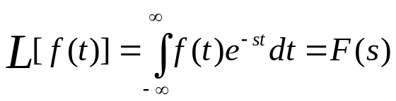

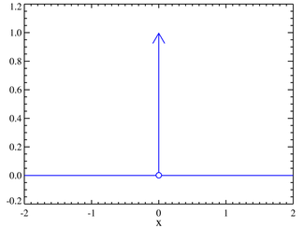
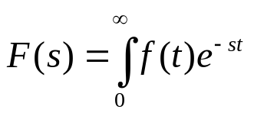

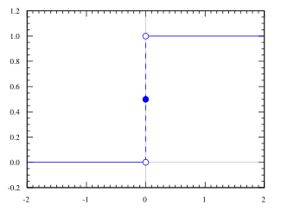

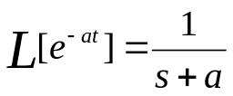



Review of Laplace Transforms
Definition
where
For Causal Systems
Common Transforms
  Impulse
  Unit Step
  Exponential
  1st Derivative
  2nd Derivative
  Convolution is multiplied
Ogata – Table in Chapter 2

Slide 8
Systems Modeling
Time Domain Modeling
Laplace Domain Modeling
  Frequency Domain
State Space Modeling
Block Diagram Modeling (Algebra)

Slide 9
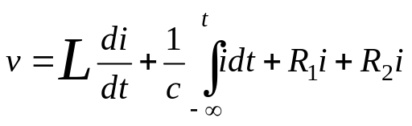
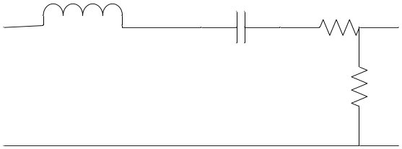
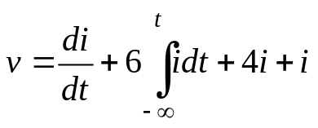






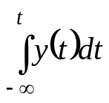
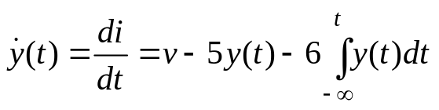


Systems Modeling
Time Domain Modeling
Using Kirckhoff's Voltage Law
  Substituting the Component Values
  Making
  Then the derivative of y(t) is:
L=1
C=1/6
R₁=4
+
v(t)
i(t)
R₂=1
y(t)
-
X

Slide 10


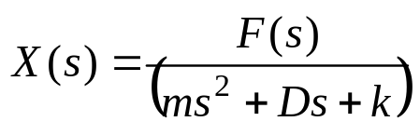








Systems Modeling
Laplace (Frequency) Domain Modeling
Static Vibration (Mass-Spring-Damper)
  Sum of the forces
  Taking the Laplace Transform of both sides and assuming that all initial conditions are zero.
  Output is equal to
  If you have everything but the Mass you could do this:
x
k
f(t)
m
D
-kx
ma
m
-Dv
X

Slide 11
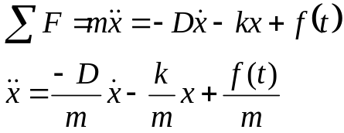
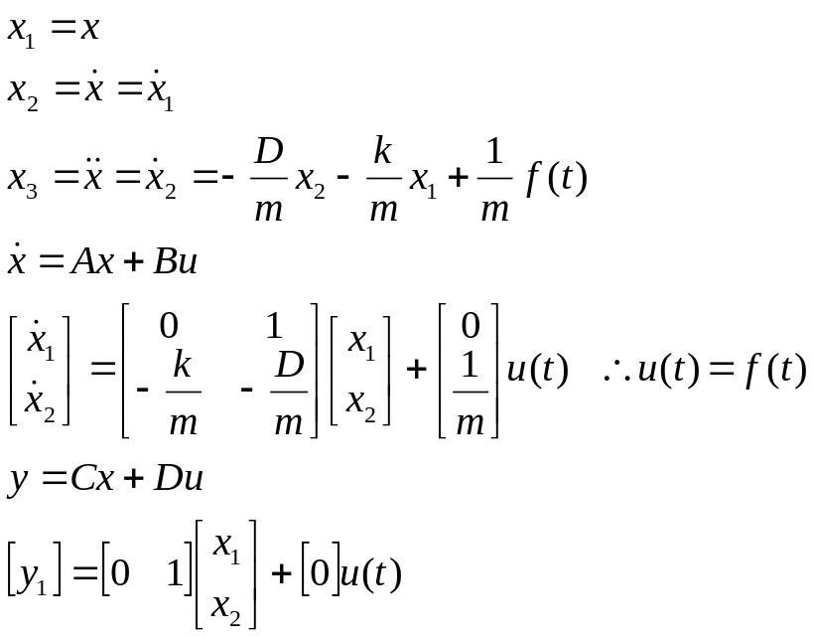

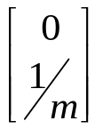


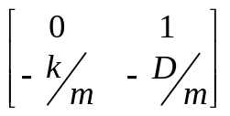
Systems Modeling
State Space Modeling
Sum of the Forces
Convert to linear algebraic expression
x
k
f(t)
m
D
X
B
A

Slide 12


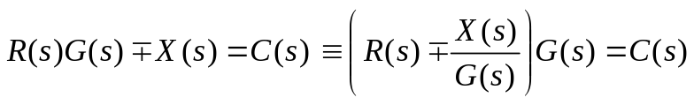


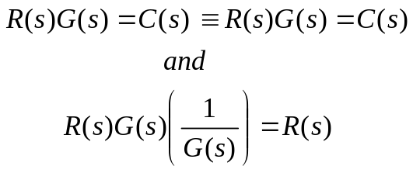
Systems Modeling
Block Diagram Algebra
R(s)
G(s)
X
C(s)
R(s)
X
C(s)
X(s)
X(s)
R(s)
X
C(s)
R(s)
G(s)
X
C(s)
X(s)
X(s)
R(s)
C(s)
R(s)
C(s)
C(s)
C(s)
R(s)
C(s)
R(s)
C(s)
R(s)
R(s)

Slide 13
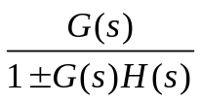




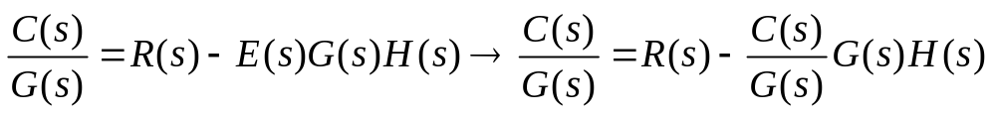
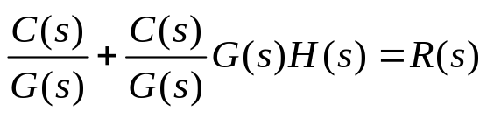
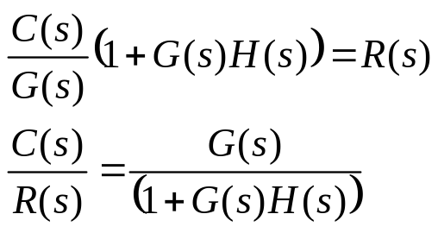
Systems Modeling
Block Diagram Algebra (Closed Loop Transfer Function)
R(s)
X
E(s)
C(s)
R(s)
C(s)
Knowing that:

Slide 14
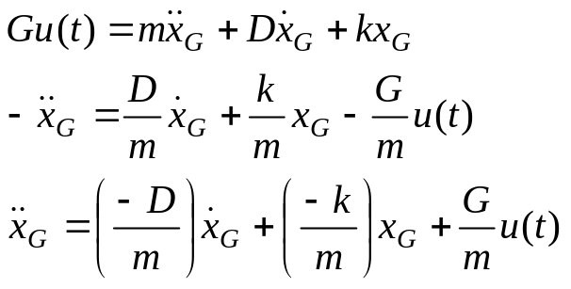

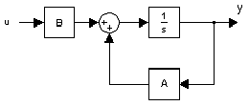

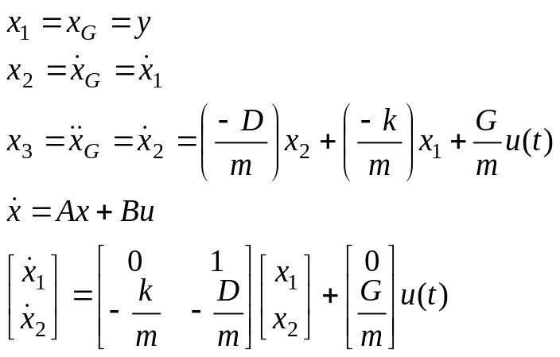
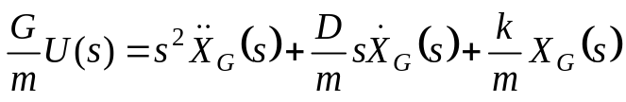




Systems Modeling
Examples
Time Domain State Space
Laplace Method
X

Slide 15
Solutions of Differential Equations
Laplace Method
State Space Method

Slide 16
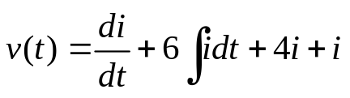
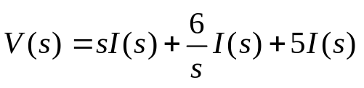
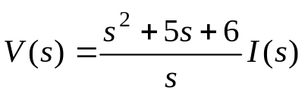


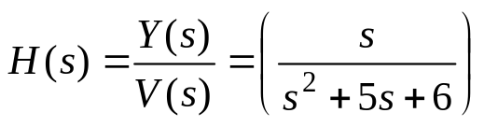
Solutions of Differential Equations
Laplace Method
RLC Circuit
Using Kirckhoff's Voltage Law
  Switching to the frequency domain
  Rearranging for the input and output of the circuit
    Input
    Output
  Deriving the Transfer Function
L=1
C=1/6
R₁=4
+
v(t)
i(t)
R₂=1
y(t)
-
V(s)
Y(s)

Slide 17
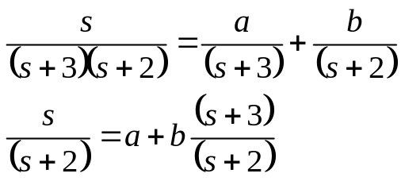
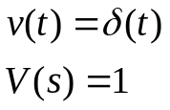
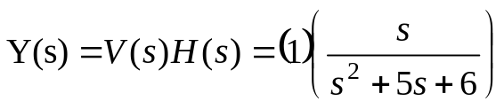
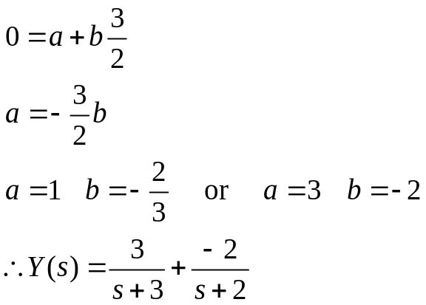
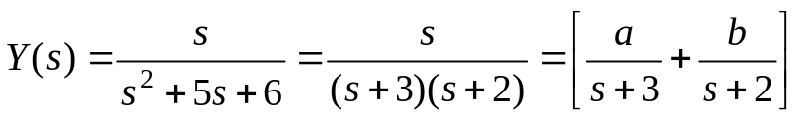

Solutions of Differential Equations
Laplace Method
System response to an impulse function at the input:
System Output
    So
Partial Fraction Expansion
for s = 0
so
Inverse Laplace Transform (Real Poles)
Ogata – Table in Chapter 2 – Laplace Transform #16

Slide 18
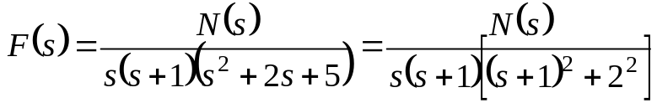
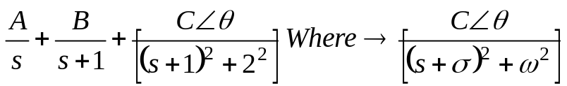
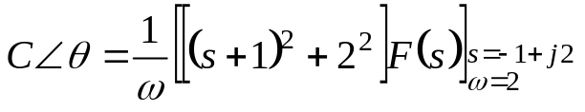

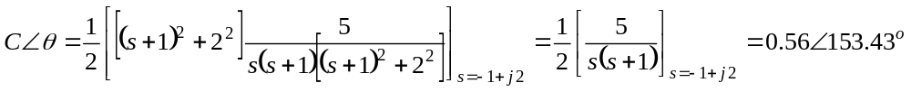
Solutions of Differential Equations
Inverse Laplace
Three types of poles
  Real & Distinct = Partial Fraction Expansion (previous slide)
  Complex or Imaginary
  Multiple Poles
Complex or Imaginary
Example
  If N(s) =5

Slide 19
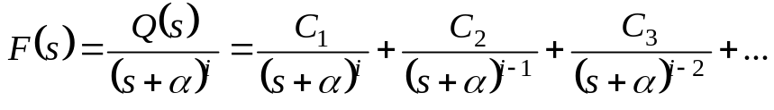
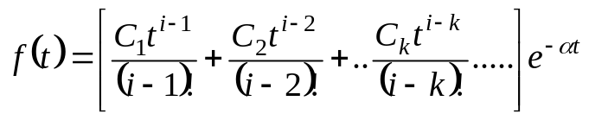
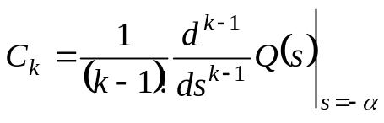
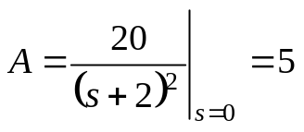
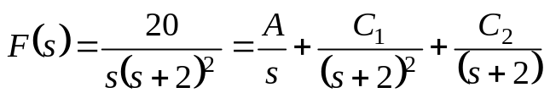
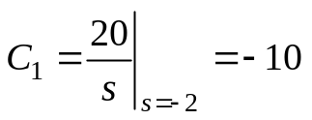
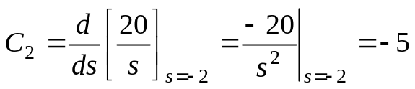


Solutions of Differential Equations
Inverse Laplace
Multiple Poles
Example

Slide 20
Solutions of Differential Equations
State Space Method
State Space Method of solution:
  Laplace
  Forcing Function

Slide 21
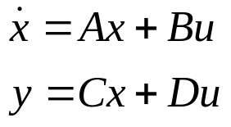

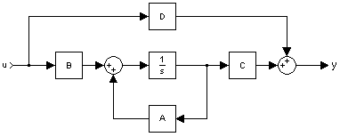
Solutions of Differential Equations
State Space Solution via Laplace Transforms (Background)
State Equation
Output Equation
Where:
  x = derivative of the state vector w/ respect to time
  y = output vector
  u = input or control vector
  A = system matrix
  B = input matrix
  C = output matrix
  D = feedforward matrix
Why is this style useful
  Systems with Single Input – Single Output
  Systems with Single Input – Multiple Output
  Systems with Multiple Input – Multiple Output
  Systems with Multiple Input – Multiple Output

Slide 22
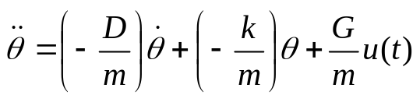
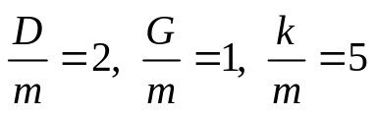

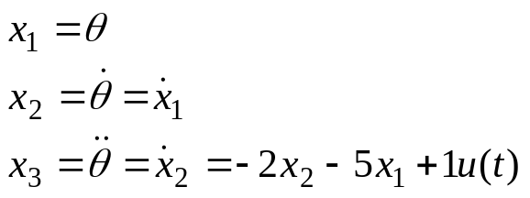



Solutions of Differential Equations
State Space Solution via Laplace Transforms
Example of Setting up the State Equation
  Make:
  So equation is now:
  Deriving the state vector:
  With these the State Equation can be formed ( ):
  where:
  so:

Slide 23








Solutions of Differential Equations
Matrix Solution of State Space
State Equation
Laplace form of State Equation
Input Matrix Reduction
Initial Conditions Forcing Function
Solving for you get the Inverse of the Matrix:

Slide 24

Solutions of Differential Equations
State Space Solution via Laplace Transforms
Reverse Linear Algebra

Slide 25



Solutions of Differential Equations
State Space Solution via Laplace Transforms
For example
Assume initial conditions = 0 for:

Slide 26



Solutions of Differential Equations
State Space Solution via Laplace Transforms
Solve for E-H via Partial Fraction Expansion
This produces:
Inverse Laplace Transform of X(s) is:

Slide 27





Solutions of Differential Equations
Matrix Solution of State Space
Output Equation
Laplace form of Output Equation
Overall Output Equation
Simplified Output Equation with initial conditions = 0 and D =0
Transfer Function
Where the C matrix is designed for what the user wants
  For Example
    If I want to find the output distance C = [1 0]
    If I want to find the velocity C = [0 1]

Slide 28


Solutions of Differential Equations
State Space Solution via Laplace Transforms
Drive Train Example
X
Motor
Clutch
Gear
Box
Sensitivity
Adjustment Gain

Slide 29







Solutions of Differential Equations
State Space Solution via Laplace Transforms
X
X

Slide 30



Solutions of Differential Equations
State Space Solution via Laplace Transforms

Slide 31








Solutions of Differential Equations
Forcing Function Solution for a State Space Model
General Expression (time domain)
General Expression (frequency domain)
Transfer Function
Split into two expressions
Solve individually
  Input Equation
  Convert to Time Domain
U(s)
Z(s)
Y(s)

Slide 32





Solutions of Differential Equations
Forcing Function Solution for a State Space Model
State Space Equation
Output Equation
  Convert to Time Domain
  Overall Output Equation

Slide 33






Solutions of Differential Equations
Forcing Function Solution for a State Space Model
Example
Start with Input

Slide 34





Solutions of Differential Equations
Forcing Function Solution for a State Space Model
Example Continued
Output
  with D=0

Slide 35
Break
10 Min Break

Slide 36
2nd Order Linear Systems
Characteristics
Definition of Order
  Degree of highest derivative in differential equation
  Degree of characteristic equation of linear system
Definition of Linear
  The system obeys the super position principal (aka Additivity).
    Which states the net response at a given place and time caused by two or more stimuli is the sum of the responses which would have been caused by each stimulus individually.
The Importance of Studying 2nd Order Systems
  Used for estimating results of Third-order and up
    3rd Order and up are complicated to solve by hand.
    Higher-order systems often behave much like 2nd order systems
  Manageable
  Many real systems (or parts of them) may be represented as second-order systems
  Many useful tools have been developed to describe and control second-order systems

Slide 37











2nd Order Linear Systems
Examples
Mechanical Example [mass spring damping]
Electrical Example [RLC Circuit]
  but where q = charge
  so

Slide 38


2nd Order Linear Systems
General Models
Time Domain Model
Frequency Domain Model
  Take Laplace Transform (including initial conditions):

Slide 39
2nd Order Linear Systems
General Models
Model Characteristics (Frequency Domain)
  Two components of solution:
    Due to input
    Due to initial condition
  Denominator is same for both (characteristic equation)
  Form of solution is determined by:
    Form of input
    Form of characteristic equation

Slide 40



2nd Order Linear Systems
General Models
Model Transient Response (Frequency Domain)
  Input Model
  System Response
  Response Structure
    Expand by partial fractions:
Steady-state response↑ ↑Transient response
(follows input (Force Response)) (follows system (Natural Response))

Slide 41



2nd Order Linear Systems
General Models
Roots of the Characteristic Equation (CE)
  General 2nd Order Characteristic:
  The Roots of the CE:
called the discriminate
  Form of the Roots (Discriminate Characteristics):
2 distinct real roots
2 identical real roots
complex-conjugate pair of imaginary roots
pure imaginary roots (unstable system)

Slide 42






2nd Order Linear Systems
General Models
2nd Order S-Domain Standard Format
  Which is another form of the transfer function
  Definitions
    The Natural Frequency (ω_{n}):
    The Damping Factor:
        so
    The Discriminate:

Slide 43




2nd Order Linear Systems
General Models
The Function of the Damping Factor
  Now rewrite equations characterizing form of roots as:
2 distinct real roots
2 identical real roots
complex-conjugate pair of imaginary roots
pure imaginary roots (unstable)
Standard Format 2nd Order Linear System
  Recall the Time Domain Model:
    Using the a & b from the previous slide
←↓Forms commonly used by control engineers

Slide 44
Step Response Input
Apply a step input to a system to determine some of the characteristics of its behavior.
Advantages
  Bounded
  Easy to apply
  Found in “real world”
  Generally easy to determine steady-state response (another step, most of the time)

Slide 45




Step Response
2nd Order Model; Step Input
Time Domain Model
Frequency Domain Model
  Make the Input a Unit Step
  Let the system be initially inert (initial conditions are zero)

Slide 46


Step Response
Steady-State Value & Normalized Step Response
Steady-State Value
  Should be less than infinity for stable system. Use final-value theorem:
Normalized Step Response
  For convenience, normalize with respect to the steady-state value.

Slide 47




Step Response
The Damping Factor (No Unstable Systems)
Definition
  The term ζ is known as the damping factor.
Case 1
  → complex-conjugate roots
  → sinusoidal transient response with (decaving) exponential envelope
Case 2
  → 2 identical real roots
  → transient of the form:
Case 3
  → 2 real roots
  → transient with two decaying exponentials
Definition
  Underdamped: ; damping not “strong enough” to completely remove oscillations
  Critically damped:
  Overdamped: ; damping so “strong” that there are no oscillations
Comments
  Only an underdamped response will cross its final value; it oscillates about the final value
  Critically damped and overdamped responses approach the final value asymptotically

Slide 48

Step Response
Responses
Underdamped
Critically Damped
Overdamped

Slide 49



Step Response
Underdamped Case (Characteristics)
System Model in the S-Domain
System Model Time Domain
  The Inverse Laplace Transform is
    Combination of step and exponentially damped sinusoid.
Ogata – Table in Chapter 2

Slide 50





Step Response
Underdamped Case (Characteristics)
Standard Solution
  Nomenclature
    Define: Phase angle
    Time constant
    Damped natural frequency
    Undamped natural frequency
    which corresponds to ζ=0 ; no exponential decay
Standard Solution

Slide 51








Step Response
Underdamped Case (Characteristics)
Graphical Meaning of the Nomenclature
  Since the roots are
  They may be plotted in the s-plane
Conclusions for vector from origin to root
  Length of vector is ω_{n}
  Real part is
  Imaginary part is ω_{d}
  Phase angle is obtained from angle vector makes with real axis
x
x

Slide 52





Step Response
Characteristics
Maxima and Minima
  Development via Differentiation
    Occurs when
    If
    Then
    But remember so

Slide 53




Step Response
Characteristics
x
Evaluate Transcendental Functions
  From s-plane plot, observe that
  Which holds if and only if
  Maxima occur for odd n; minima occur for even n
  First peak and maximum value (Peak Time) occur when n=1, at time:

Slide 54




Step Response
Characteristics
Peak Overshoot (% Overshoot)
The y_{max} is found with the Peak Time
  Since the unit step was used earlier, y_{final} = 1
  so
Maximum Peak Overshoot

Slide 55







Step Response
Characteristics
Settling Time (t_{s})
  Exponential envelope determines how quickly transient settles out and steady-state value is reached. Define settling time to be time it takes to fall within ± 2% of steady-state.
Rise Time (t_{r})
  Is the amount of time required for the response to first reach its steady-state value at 100% (10 to 90% for overdamped).
  Unit Step Response is:
  so and
  so
  thus and the overall t_{r} is:

Slide 56





Step Response
Characteristics
Graphical Meaning of the Step Response Characteristics
0.9
0.1

Slide 57




Step Response
Characteristics Summary
Maxima
  Occurs when n is odd
Minima
  Occurs when n is even
Peak Overshoot
  Occurs when:
  % Overshoot:
Settling Time (t_{s})
Rise Time (t_{r})

Slide 58

Step Response
Example
For:
  Calculate
    Damping factor ζ
    Natural frequency ω_{n}
    Damped natural frequency ω_{d}
    Settling time t_{s}
    Rise time t_{r}
    Normalized peak overshoot M_{p}

Slide 59







Step Response
Numerical Examples of Transient
Responses for 2nd Order, Underdamped Systems
  Step Input
    so so

Slide 60
Break
10 Min Break

Slide 61
Root Locus & PID Controller
Determining Stability and Designing for Robustness via Root Locus Methods
  Definitions
  Development of Technique
PID Controller
  Gains
  Tuning
  Design

Slide 62

Root Locus Method
Definitions
Technique invented by Walter R. Evans of 1944 C-Class.
Convenient procedure for obtaining information about closed-loop feedback systems. The root locus is a plot in the s-plane of all possible locations that the roots of a closed-loop system.
Definitions of Poles and Zeros
  Model:
  Transfer Function:
    For a system with transfer function
    Pole– any value of s for which T(s) = ∞
    Zero– any value of s for which T(s) = 0
X(s)
T(s)
Y(s)

Slide 63

Root Locus Method
Example
Example (General Case Polynomial)
  Let T(s) be the ratio of two polynomials:
    Roots of N(s) = 0 are zeros.
    Roots of D(s) = 0 are poles.
    Poles are roots of characteristic equation and determine stability.
      m > n → pole at s = ∞
      m < n → zero at s = ∞

Slide 64








Root Locus Method
Complex Variable and Polar Coordinates
Complex Variable
  Express ‘s’ as a complex variable:
Magnitude Phase
Examples

Slide 65

Root Locus Method
Complex Variable and Polar Coordinates
Alternate Form (Using Euler Identity)

Slide 66


Root Locus Method
Development of the Technique
System Model
  Consider the simple feedback system:
Transfer Function
System Poles
  Poles are values of ‘s’ where the transfer function becomes infinite. Thus, the denominator is
X(s)
+
G(s)
Y(s)
-
H(s)

Slide 67



Root Locus Method
Development of the Technique
Closed-Loop Poles
  Occur where
Open-Loop Poles and Zeros
  Let G(s)H(s) be a ratio of two polynomials:
  Open-loop zeros– all zeros of G(s) and H(s)
  Open-loop poles– all poles of G(s) and H(s)
    Since ‘s’ is a complex number, G(s), H(s), and G(s)H(s) are also complex.

Slide 68


Root Locus Method
Summary
Function
  Root locus method shows how to find closed-loop poles in terms of open-loop poles and zeros.
Definition
  The root locus is defined as the set of points in the s-plane where
Loop Gain K
  The parameter K is varied, but at each point on the locus (Observe )
  For a set of open-loop poles and zeros, this procedure enables the designer to select a gain K for the system to meet certain closed-loop performance criteria.

Slide 69


Root Locus
Root Locus with Gain = 25.1056

Slide 70


Root Locus
Root Locus with Gain = 25.1057

Slide 71


PID Controller
Proportional-Integral-Derivative Controller (PID)
  Controller used to attempt to correct the error between a measured variable and a desired setpoint variable. Used to minimize transient response.
  Gain’s (K) are the tunable parameters
Controller Transfer Function:

Slide 72
PID Controller
Gains
It’s a Game of Give and Take
Proportional Characteristics
  Higher P gain’s display larger changes in system output error, faster responses.
  Gain’s that are to high can cause the system to become unstable.
  Low P gain’s display small if not (slow) response changes to a system.
Integral Characteristics
  Larger I gain’s helps eliminate steady state errors.
  Negative the larger the I gain the more overshoot present in a system.
Derivative Characteristics
  Slows the rate of change of the output response of the system.
  Larger D gain’s decrease the overshoot of the system, which is magnified by the Integral component.
  Negative trait is that it amplifies any noise in a system, which could case a system to become unstable.
NOTE: Unstable systems could cause damage to your system.

Slide 73
PID Controller
Tuning
Tuning Methods
  Routh-Hurwitz Stability Criterion technique
    Used for P gain
  Manual Tuning
    Time Consuming
  Ziegler-Nichols Method
    Used to set each gain individually
  PID Gain Software
    Found online everywhere

Slide 74
PID Controller
Design
Design Aspects to Using a PID Controller
  Evaluate the original performance of the uncompensated system to determine what improvements need to be made.
  Design the PD controller to meet the transient response spec.
  Simulate the system to be sure all requirements are now met.
  Redesign if the previous simulation shows that all requirements are not met.
  Design the PI controller to yield the required steady state error.
  Determine the exact gains; Kp, Ki, Kd
  Simulate the system to be sure all requirements are met.
  Redesign if all requirements are still not met. Restart at step 2 above.

Slide 75
PID Controller
Conclusion
PID Controllers at times are an easy solution to control the output of a control system.
Custom Design: PI, PD, PID
Proportional for Rise Time
Integral for Steady-State Error
Derivative for Overshoot
PID are not fool proof and could cause your system to not work properly. If they go unstable they could cause damage to components of your system.
It’s a Game of Give and Take

Slide 76
Additional Resources Ranked in Order
Ogata, Katsuhiko. System Dynamics, Fourth Edition. New Jersey: Pearson Prentice Hall, 2004.
Nise, Norman S. Control Systems Engineering, Fourth Edition. New Jersey: John Wiley & Sons, 2004.
Bishop, Robert H. Modern Control Systems, Tenth Edition. New Jersey: Prentice Hall, 2005.
Brogan, William L., Modern Control Theory. New Jersey: Prentice Hall, 1991.
Fundamentals of Engineering Supplied-Reference Handbook, Sixth Edition. South Carolina: National Council of Examiners for Engineering and Surveying, 2003.

Slide 77
Backup Slides
Bode Plots
  Design Methods

Slide 78

Use of Bode Plots for Compensating Systems
Construction of Gain vs. Frequency Plots given the System Transfer Function
  In this topic, we will discuss a simple technique for plotting the gain of a system as a function of frequency, given the transfer function of the system in factored form
  Gain frequency plots are also called Bode plots, after Hendrik Bode who developed the technique at bell labs in the 1930’s
  Statement of the problem:
    Given a transfer function in factored form, for example:
    We desire to plot | T (jw) | versus w from values of w near zero through to very large values.

Slide 79

Bode Plots
Method 1
Brute Force Calculation of |T(jw)|
  Substitute s = jw₁ into T(s) where w₁ is a particular frequency
  Evaluate |T(jw₁)| by the ordinary algebra of complex numbers
  Repeat steps 1 and 2 for each different w₁ required to cover the frequency range of interest
For the example above
Shortcomings
  Considerable amount of tedious algebra is required (5 multiplications or divisions)
  May miss a peak due to large sampling interval

Slide 80



Bode Plots
Method 2
Compute Gain of T(jw) in dB:
  Example
  Example
Advantages
  Additions and subtractions required (instead of multiplications and divisions)
  We will see that sharp peaks will not be missed

Slide 81

Bode Plots
Frequency Scale
Plot Gain vs. Log (w)
Advantages
  Gain plot is simpler to construct
  Portray both low and high frequency behaviors on same plot
Gain
(dB) 20
0
-20
-40
-60
1 2 3 4 5 Log w
10 10² 10³ 10⁴ 10⁵ w (use Log paper)
http://www.csun.edu/~vceed002/ref/measurement/data/graph_paper.html

Slide 82

Bode Plots dB Gain for a Linear Factor
A general linear factor for a transfer function is: as + b
  G₁ = 20 Log | ajw + b |
Consider behavior at very low frequencies
G_{1LF} = 20 Log (b)
Low Frequency
20 Log (b) Response
w
Consider behavior at very high frequencies
  G_{1HF} = 20 Log (aw) = 20 Log (a) + 20 Log (w)
  Since G_{1HF} is a constant plus 20 times Log (w) we have a straight line (we plot G vs. Log (w)) with a slope of 20 dB/decade
  When w = 1 / a , G_{1HF} = 20 Log (wa) = 20 Log (1) = 0

Slide 83
Bode Plots dB Gain for a Linear Factor
Gain (dB)
Two straight lines are known as the “low frequency asymptote” and the “high frequency asymptote”
  As w → 0, G₁ approaches low frequency asymptote
  As w → ∞, G₁ approaches high frequency asymptote
It turns out, extending the straight lines to their point of intersection gives a reasonably good piecewise-linear approximation to the actual G₁ curve
The asymptotes meet when
20 Log (b) = 20 Log (aw_{b}) …OR… b = aw_{b} → w_{b} = b / a
    w_{b} is known as break frequency
20 Log (a) + 20 Log (ω)
20 Log (b)
1/a
ω_{b} = b/a
ω

Slide 84
Bode Plots dB Gain for a Linear Factor
We now have
where
  G₁ = 20 Log | as + b |
Gain (dB)
20 Log (a) + 20 Log (ω)
20 Log (b)
1/a
ω_{b} = b/a
ω

Slide 85
Bode Plots
Example 1
Using: T(s) = 2s + 8
Step 1: LF Behavior (s small)
G_{LF} = 20 Log (8) = 18 dB
Step 2: HF Behavior (s large)
G_{HF} = 20 Log (2w)
= 20 Log (2) + 20 Log (w)
= 6 + 20 Log (w) dB
Straight line with slope +20 dB/decade and a zero crossing at 2w = 1 or w = ½
Step 3: Break Freq. = 8/2 = 4
Lead Filter
Increasing in Freq
Gain (dB)
20 dB/decade
18
0.5
4
ω

Slide 86


Bode Plots
Example 2
Using:
Note that this = 1 / H(s) where H(s) was the previous example.
Thus:
which is the negative of the previous example.
The gain for a factor in the denominator is the negative of what it would be if the factor were in the numerator.
0.5
4
ω
-18
-20 dB/decade
Gain (dB)

Slide 87

Bode Plots
Example 3
Note: For multiple terms, the total gain plot is the sum of the gain plots for each term.

Slide 88

Bode Plots
Characteristics
Gain Characteristics for Term 2s + 8
  LF Behavior (s small)
  G_{LF} = 20 Log (8) = 18 dB
  HF Behavior (s large)
  G_{HF} = 20 Log (2w) = 20 Log (2) + 20 Log (w) = 6 + 20 Log (w) dB
  Break Frequency
  2w = 8 or w = 4
Gain Characteristics for Term 1/(s+8)
  LF Behavior (s small)
  G_{LF} = -20 Log (8) = -18 dB
  HF Behavior (s large)
  G_{HF} = -20 Log (w) dB
  Break Frequency
  w = 8
Gain Characteristics of First Term MINUS Gain Characteristics of Second Term
  LF Behavior
  18 – 18 = 0 dB
  HF Behavior
  6 + 20 Log (w) – 20 Log (w) = 6 dB

Slide 89


Bode Plots
We now know how to construct the asymptote gain plot for single linear factor
  or
With this knowledge, we can now construct an asymptotic gain plot for any transfer function which contains only real poles and zeros
The construction is based on the observations
  At a numerator break frequency, the slope increases by 20 dB/decade
  At a denominator break frequency, the slope decreases by 20 dB/decade
  Each break frequency is found by equating the LF and HF approximations for the factor

Slide 90

Bode Plots
A More Complex Example
We construct the piecewise-linear approximation to the gain characteristic (in dB vs. Log w) in the following steps:
  Calculate all break frequencies
Numerator Factors | LF Curve | HF Curve | Equation HF = LF | Break Freq. (w)
s + 2 | 20 Log (2) | 20 Log (w) | w = 2 | 2
3s + 30 | 20 Log (30) | 20 Log (3w) | 3w = 30 | 10
Denominator Factors
s + 1 | 20 Log (1) | 20 Log (w) | w = 1 | 1
s + 5 | 20 Log (5) | 20 Log (w) | w = 5 | 5
s + 8 | 20 Log (8) | 20 Log (w) | w = 8 | 8
6s + 72 | 20 Log (72) | 20 Log (6w) | 6w = 72 | 12

Slide 91

Bode Plots
A More Complex Example
  Determine the frequency range of interest.
  Rule of thumb: Cover a range from 1 decade below the lowest break frequency (w_{b}=1) to 1 decade above the highest break frequency (w_{b}=12)
  For this example, we want our frequency range to be from 0.1 rad/s to 120 rad/s ≈ 100 rad/s

Slide 92



Bode Plots
A More Complex Example
  Find LF and HF approximations for entire transfer function
  LF: w small
Thus LF asymptote is a horizontal line (zero slope) and a gain of 12 dB
HF: w large

Slide 93



Bode Plots
A More Complex Example
  At the highest w on graph paper (ω=100), the gain is
  Therefore the HF asymptote is defined by the two conditions:
  G = -40 dB at ω = 100 rad/s
  Slope of G = -40 dB/decade
  Label vertical axes of graph paper
  somewhat arbitrarily

Slide 94

Bode Plots
A More Complex Example
  Draw the high and low frequency asymptotes
  Now construct total asymptotic gain characteristic starting from LF asymptote and extending line to smallest break frequency (w=1). Since this is a denominator factor, the slope changes by -20 dB/decade.

Slide 95

Bode Plots
A More Complex Example

Slide 96



Bode Plots
Another Example
Follow same steps as before:
  Numerator break frequency: 10
  Denominator break frequency: 2, 2, 20
  Frequency range:
    Lowest break frequency = 2
    Highest break frequency = 20
    Range of interest is 0.2 to 200 or 0.1 to 1000
  LF asymptote: w small
  Straight line with slope of -20 dB/decade and at lowest frequency of interest (w=0.1)

Slide 97


Bode Plots
Another Example
  HF asymptote:
  Straight line with slope of -60 dB/decade and at the highest frequency of interest
  Gain range of interest: +60 dB to -140 dB
  The asymptotic gain characteristic is now drawn by
    Constructing LF and HF asymptotes
    Working from LF asymptote upward in w

Slide 98

Bode Plots
Another Example
Numerator Break Frequency
  10
Denominator Break Frequency
  2, 2 and 20

Slide 99

Bode Plots
Corrections for Asymptotic Gain Characteristics
Asymptotic plots are good approximations to the actual gain curves for most cases
However, appropriate corrections can be added
Consider a numerator factor
  Corrections for a numerator:
    +3 dB at break frequency
    +1 dB an octave above and below the break frequency

Slide 100


Bode Plots
Corrections for Asymptotic Gain Characteristics
Similarly, the corrections for a denominator factor are:
We can often make adequate corrections by drawing a smooth curve following the asymptotic plot

Slide 101

Bode and Phase Diagram
1000
0.00025 s² + 0.5 s + 1000

Slide 102



Bode Plots
Complex Poles and Zeros
The approach is similar to that for real poles and zeros
  Consider the example:
  Determine break frequencies
  The frequency range of interest is from 0.1 to 1000 rad/s
  The LF and HF asymptotes are
        Slope= -20 dB/decade
        Slope = 0
  Let gain scale go from 20 dB to -60 dB
Numerator Factor | LF Curve | HF Curve | Equation HF = LF | Break Freq. (w)
s + 16 | 20 Log (16) | 20 Log (w) | w = 16 | 16
Denominator Factor | LF Curve | HF Curve | Equation HF = LF | Break Freq. (w)
3s² + 6s + 48 | 20 Log (48) | 20 Log (3w²) = 20 Log (3) + 40 Log (w) | 3w² = 48 | 4

Slide 103

Bode Plots
Complex Poles and Zeros
  Construct asymptotic plot
Numerator break frequency: 16
Denominator break frequency: 4, 4

